Slide 1

Title: Data Analyst Capstone Project Report
Learner Name: Aryan Awachat
Date: 15/06/2026

Slide 2



OUTLINE
Executive Summary
Introduction
Methodology
Results
Visualization – Charts
Dashboard
Discussion
Findings & Implications
Conclusion
Appendix

Slide 3

EXECUTIVE SUMMARY
This project analyzes current and future technology trends using data collected from APIs, web scraping, and developer survey datasets.
Key findings indicate that Python, JavaScript, SQL, and cloud technologies continue to dominate the technology landscape. PostgreSQL and MongoDB are emerging as highly preferred databases among developers.
Dashboard analysis reveals strong growth in data-related technologies, increasing demand for modern databases, and continued importance of programming skills across industries.
The results provide valuable insights for students, professionals, recruiters, and organizations seeking to align their skills and hiring strategies with industry demand

Slide 4

INTRODUCTION
Purpose
To identify current and future technology trends through data analysis and visualization.
Target Audience
Students
Data Analysts
Software Developers
Recruiters
Technology Managers
Business Value
Understand market demand
Identify emerging technologies
Support career planning
Guide organizational technology decisions

Slide 5

METHODOLOGY
Data Sources
Job Posting API
Web Scraped Salary Data
Stack Overflow Developer Survey Dataset
Data Collection
API requests using Python
HTML scraping using BeautifulSoup
Survey data extraction
Data Cleaning
Removed duplicate records
Handled missing values
Standardized variables
Tools Used
Python
Pandas
Matplotlib
Seaborn
Plotly
IBM Cognos Analytics

Slide 6

Results
<Please present your results in the following slides.>

Slide 7
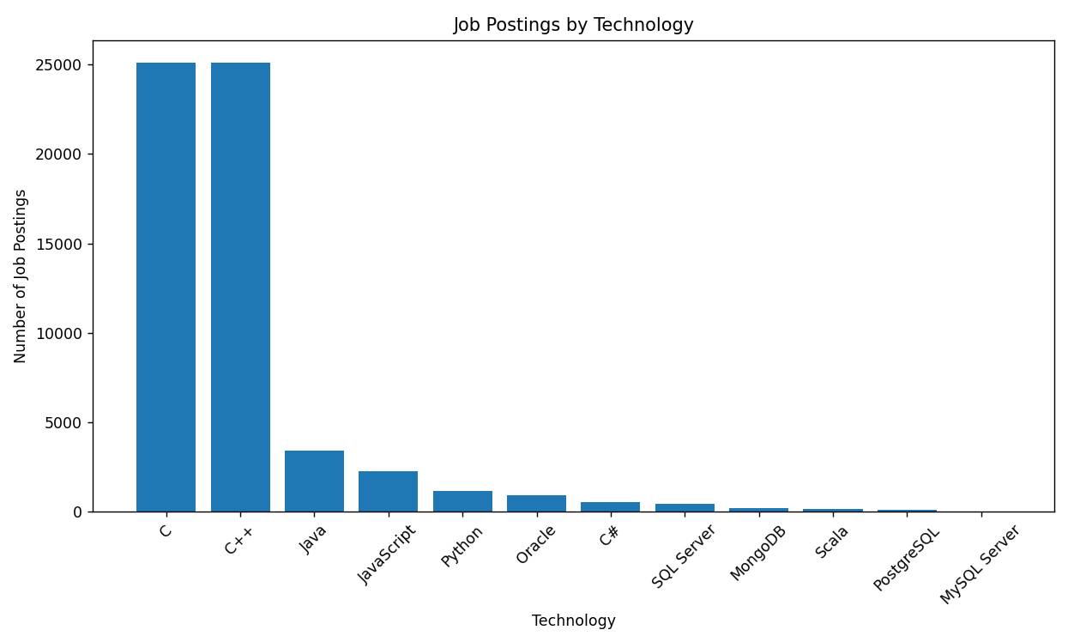
JOB POSTINGS
In Module 1 you have collected the job posting data using Job API in a file named “job-postings.xlsx”. Present that data using a bar chart here. Order the bar chart in the descending order of the number of job postings.

Slide 8
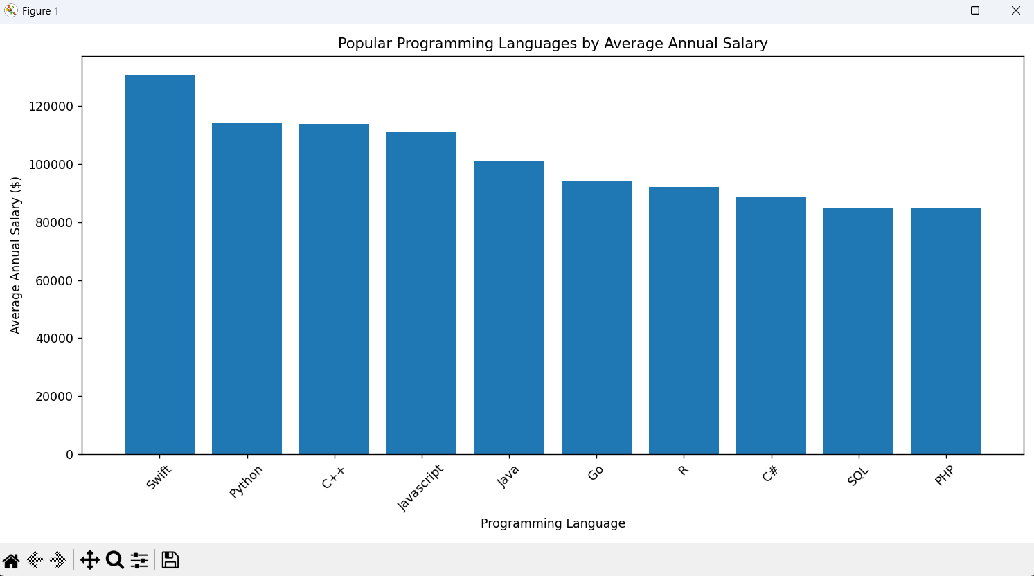
POPULAR LANGUAGES
In Module 1 you have collected the job postings data using web scraping in a file named “popular-languages.csv”. Present that data using a bar chart here. Order the bar chart in the descending order of salary.

Slide 9
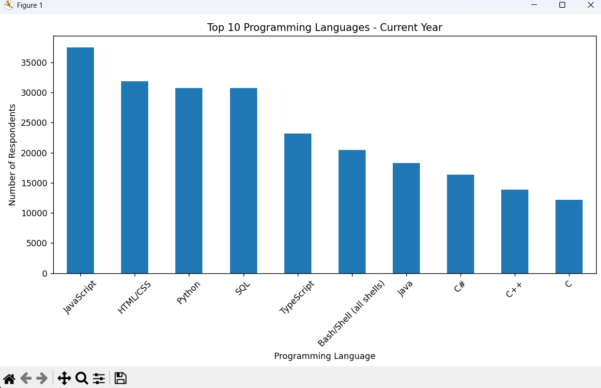
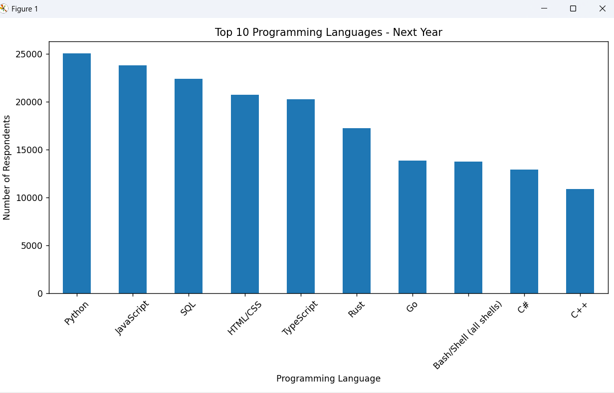
PROGRAMMING LANGUAGE TRENDS
Summarize key trends shown in the charts.
Current Year
Next Year
The current technology landscape is dominated by JavaScript, HTML/CSS, SQL, and Python. Analysis of future preferences shows growing interest in Python and other modern technologies, indicating continued expansion in data analytics, artificial intelligence, cloud computing, and software development. These trends suggest that professionals with strong programming skills, particularly in Python and JavaScript, will remain highly sought after in the job market.

Slide 10
PROGRAMMING LANGUAGE TRENDS - FINDINGS & IMPLICATIONS
Findings
Python continues to gain popularity and shows strong future growth due to its applications in Data Science, AI, Machine Learning, and Automation.
JavaScript remains one of the most widely used programming languages, maintaining its importance in web and full-stack development.
SQL continues to be a critical skill for data analysis, database management, and business intelligence applications.
Implications
Professionals should prioritize learning Python, SQL, and JavaScript to remain competitive in the evolving job market.
Organizations should invest in training and development programs focused on modern programming and data technologies.
Future hiring demand is expected to increase for candidates with expertise in analytics, cloud computing, artificial intelligence, and software development.

Slide 11
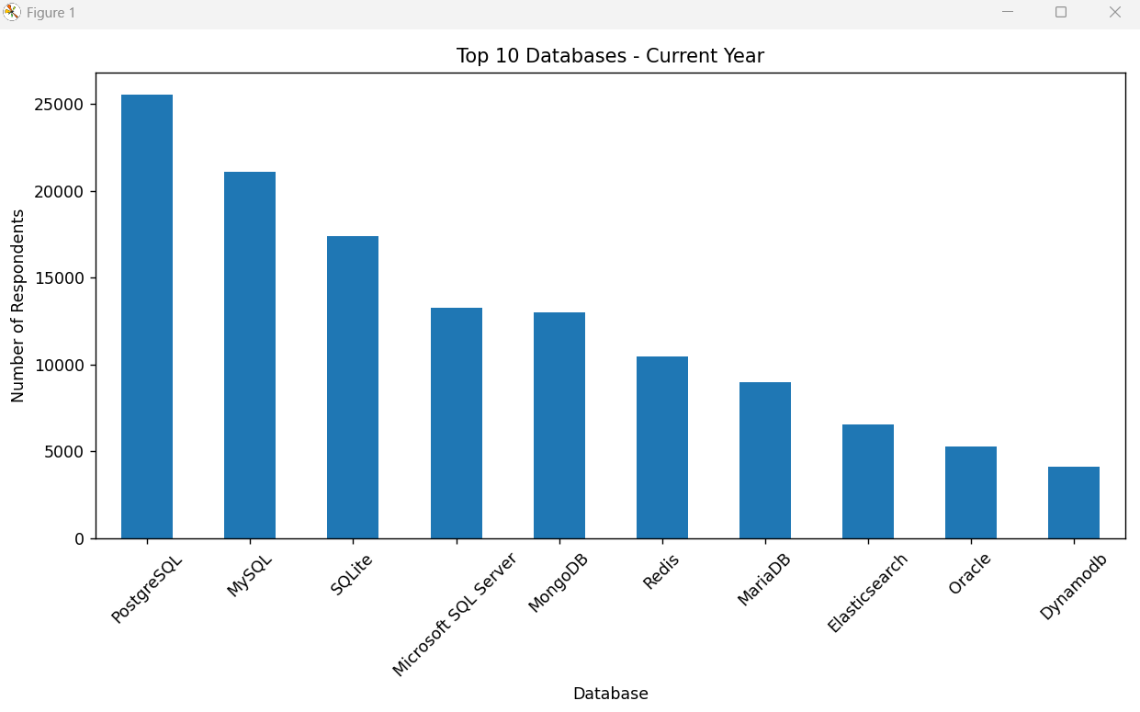
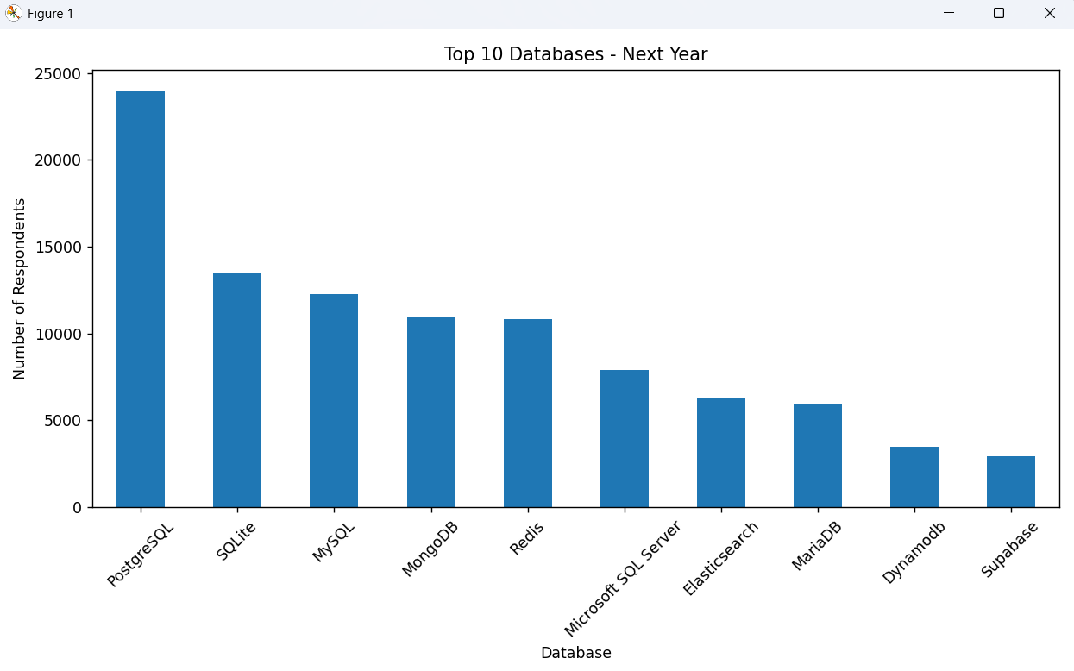
DATABASE TRENDS
Summarize key trends shown in the charts.
Current Year
Next Year

Slide 12
DATABASE TRENDS
Summarize key trends shown in the charts.
Current Year
PostgreSQL, MySQL, Microsoft SQL Server, and MongoDB are among the most widely used database technologies.
Relational databases continue to dominate enterprise applications.
Organizations rely heavily on databases for data management, reporting, and analytics.
Next Year
PostgreSQL shows strong growth in developer preference.
MongoDB continues gaining popularity for modern web and cloud applications.
Interest in cloud-ready and scalable database technologies is increasing.
Both SQL and NoSQL databases are expected to remain important in future technology ecosystems.

Slide 13
DATABASE TRENDS - FINDINGS & IMPLICATIONS
Findings
PostgreSQL is one of the fastest-growing databases, showing increased interest among developers for future use.
MySQL and Microsoft SQL Server remain widely used, highlighting the continued importance of relational databases.
MongoDB continues gaining popularity, reflecting the growing demand for NoSQL databases in modern applications.
Implications
Professionals should develop skills in both SQL and NoSQL databases to remain competitive in the job market.
Organizations should invest in scalable and cloud-ready database technologies to support future growth.
Demand for database management, data engineering, and analytics expertise is expected to increase as data-driven decision making becomes more important.

Slide 14

DASHBOARD
<Please present your dashboard in the following slides.>

Slide 15
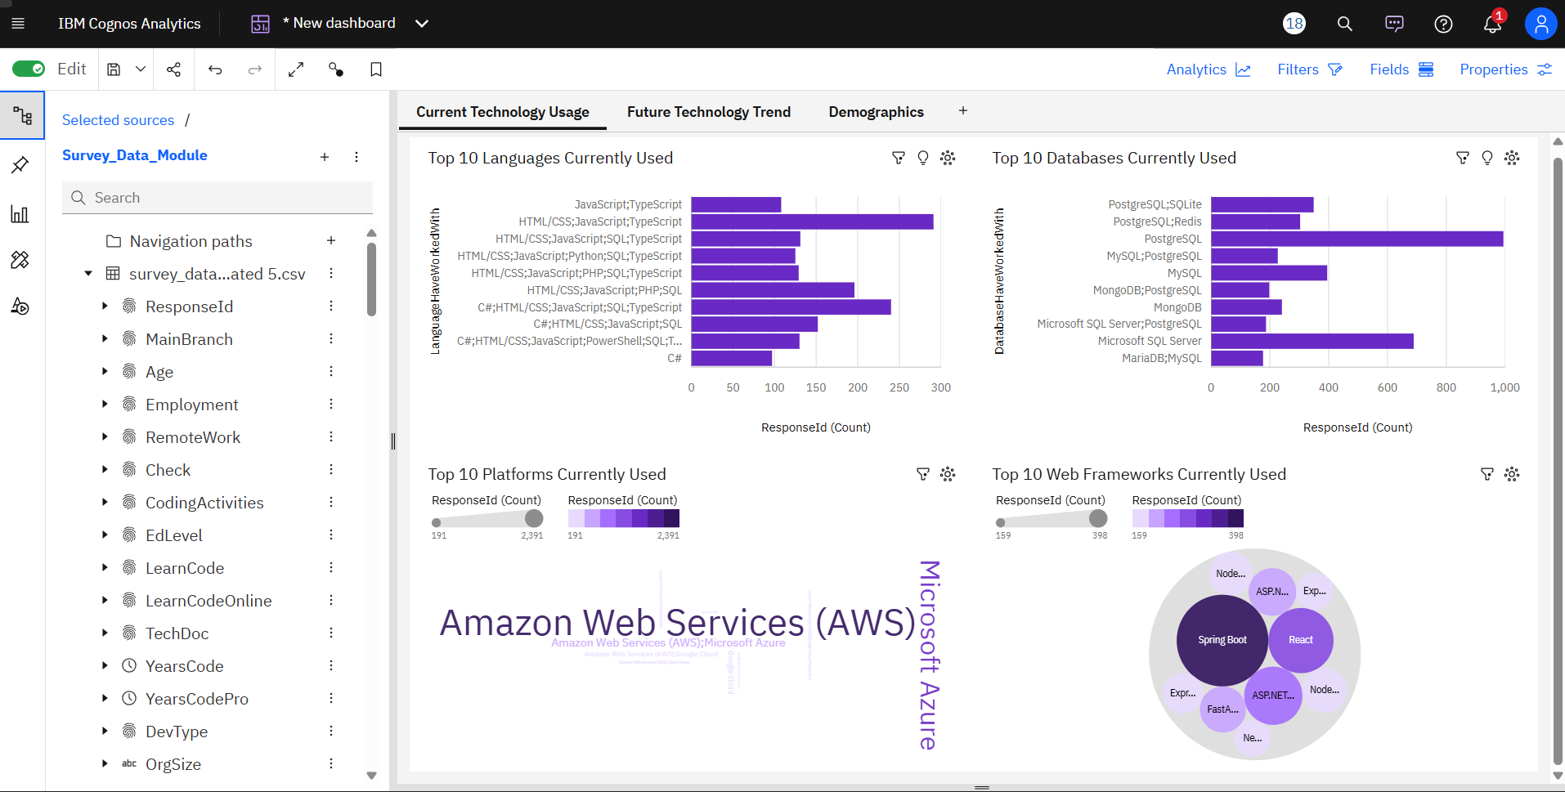
DASHBOARD TAB 1: Current Technology Usage

Slide 16
DASHBOARD TAB 1: Current Technology Usage
Key Insights
JavaScript, HTML/CSS, TypeScript, and C# are among the most widely used programming languages by survey respondents.
PostgreSQL, Microsoft SQL Server, MySQL, and MongoDB are the most commonly used database technologies.
Amazon Web Services (AWS) and Microsoft Azure dominate the cloud platform landscape, indicating strong adoption of cloud computing technologies.
React, Spring Boot, ASP.NET, and Express are among the most frequently used web frameworks, highlighting the popularity of modern web application development.
The results suggest that full-stack development skills and cloud-platform expertise remain highly relevant in the current technology market.
Business Implications
Organizations should prioritize hiring professionals with expertise in JavaScript, cloud platforms, and modern web frameworks.
Training programs should focus on cloud technologies and full-stack development to meet industry demand.
Database skills in PostgreSQL, SQL Server, and MongoDB continue to be valuable for data-driven applications.
Developers seeking career growth should consider strengthening skills in cloud services and popular web frameworks.

Slide 17
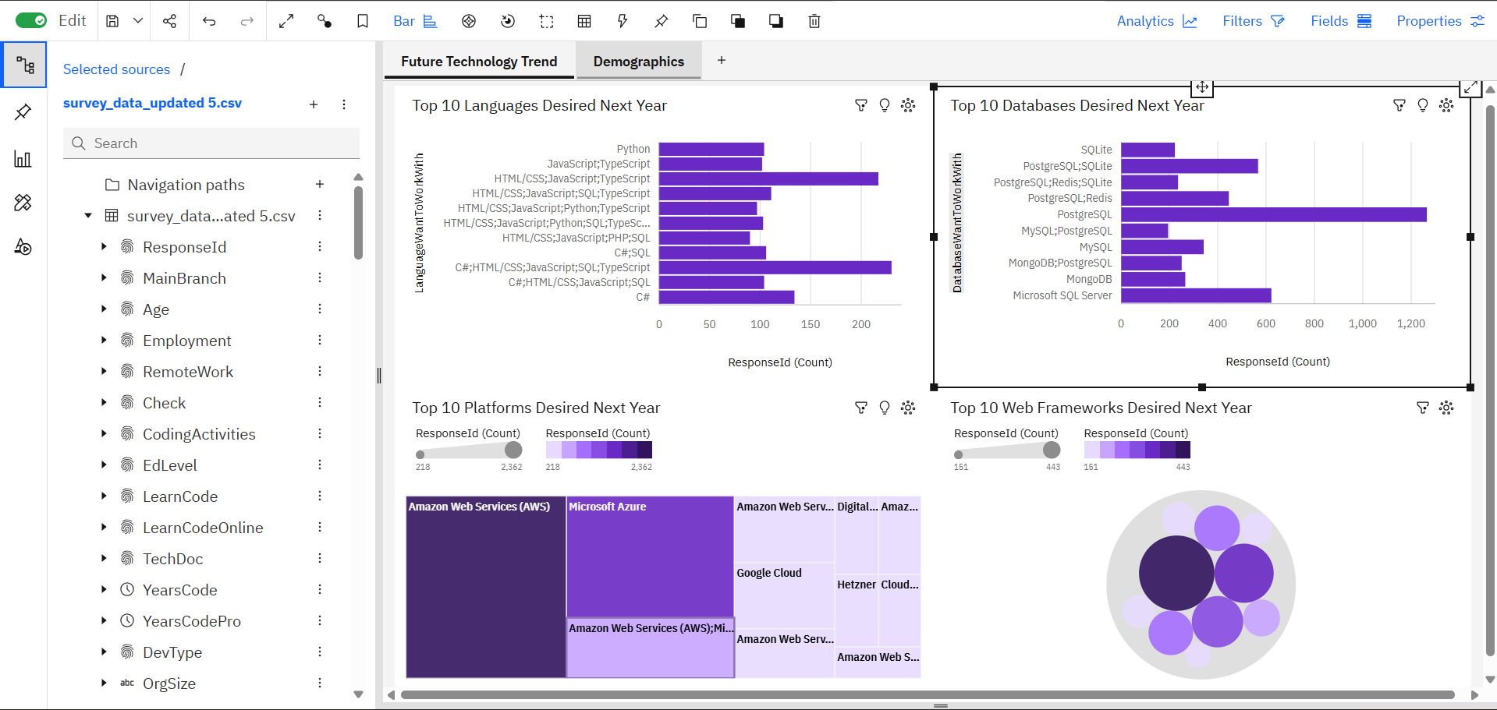
DASHBOARD TAB 2: Future Technology Trends

Slide 18
DASHBOARD TAB 2: Future Technology Trends
Key Insights
Python, JavaScript, TypeScript, and Go are among the most desired programming languages for future work.
PostgreSQL and MongoDB continue to attract strong interest among developers.
Cloud platforms such as AWS and Microsoft Azure remain highly preferred for future projects.
Modern web frameworks including React, Angular, and Node.js are expected to remain in high demand.
Implications
Future technology trends indicate growing demand for cloud computing, modern web development, and data-driven technologies.
Professionals should focus on upskilling in emerging technologies to remain competitive.
Organizations can use these trends to guide technology adoption and workforce development strategies.

Slide 19
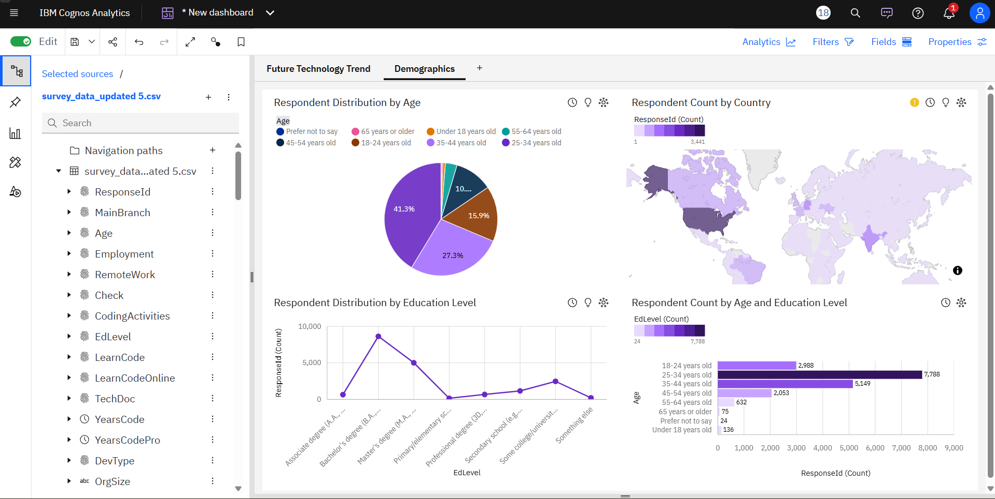
DASHBOARD TAB 3: Demographics

Slide 20
DASHBOARD TAB 3: Demographics
Dashboard Insight – Demographic Insights
The survey respondents are primarily concentrated in the young to middle-age groups, indicating that the technology workforce is largely composed of early- and mid-career professionals.
Respondents are distributed across multiple countries, showing a globally diverse developer community with strong participation from major technology markets.
Most respondents possess higher education qualifications, such as bachelor's or master's degrees, highlighting the importance of formal education in technology careers.
Across different age groups, respondents with higher education levels consistently represent a significant proportion of the workforce, suggesting a strong relationship between education and participation in the technology industry.
The demographic trends indicate that the future technology workforce is likely to remain highly educated, globally connected, and concentrated among younger professionals.

Slide 21
DISCUSSION
Overall Insights Derived from Dashboards
JavaScript, HTML/CSS, Python, and SQL remain among the most widely used technologies, demonstrating their continued importance in software development and data-related roles.
Interest in Python, cloud platforms, and modern web frameworks is expected to grow in the coming years, indicating strong future demand for these skills.
Amazon Web Services (AWS) and Microsoft Azure are the leading cloud platforms currently used and are also among the most desired technologies for future adoption.
PostgreSQL, MySQL, and Microsoft SQL Server are popular database technologies, with PostgreSQL showing particularly strong future interest among developers.
The developer community is highly global and diverse, with significant participation from multiple countries and regions.
Most respondents are 25–44 years old and possess Bachelor's or Master's degrees, suggesting that the technology workforce is largely composed of educated early- and mid-career professionals.
The comparison between current and future technology trends indicates a shift toward cloud computing, open-source technologies, modern databases, and data-driven development practices.

Slide 22
OVERALL FINDINGS & IMPLICATIONS
Findings
JavaScript, HTML/CSS, Python, and SQL are among the most widely used technologies by developers today.
Cloud platforms, especially AWS and Microsoft Azure, show strong current adoption and continued future interest.
PostgreSQL and modern web frameworks demonstrate increasing popularity and future growth potential.
Implications
Organizations should invest in cloud computing, modern databases, and web development technologies to remain competitive.
Professionals can improve career prospects by developing skills in Python, cloud platforms, and modern frameworks.
The technology industry is increasingly driven by highly educated, globally distributed, and early-to-mid career professionals.

Slide 23

CONCLUSION
The analysis of current technology usage, future technology trends, and developer demographics reveals that the technology industry continues to evolve toward cloud-based, data-driven, and modern development practices.
Technologies such as JavaScript, Python, SQL, PostgreSQL, AWS, and Microsoft Azure demonstrate both strong current adoption and high future demand.
The survey also highlights that the developer community is globally distributed and largely composed of highly educated professionals in the 25–44 age range. This suggests that continuous learning and adaptation to emerging technologies are critical for career growth and organizational success.
Overall, organizations should prioritize investments in cloud computing, modern databases, and web development technologies, while professionals should focus on developing skills in these high-demand areas to remain competitive in the evolving technology landscape.

Slide 24

APPENDIX
Include any relevant additional charts, or tables that you may have created during the analysis phase.

